Slide 1
Updates and Reminders
Final Primary Research Workshop on MONDAY 2/24
Group Project Submission Due FRIDAY 2/28
Extra Credit Opportunity: 2 extra credit points on Quiz #3
Attend BBT Departmental Research Seminar Series on TUESDAY 2/25 at 4:10pm-5:00 in GP1002 and complete a brief worksheet.
Daniella Cimini from Virginia Tech will present on her research Lab’s current work to understand changes in cancer cells that contribute to aneuploidy and genomic instability
attend, sign in on the sign-in sheet, submit the completed worksheet on canvas before midnight on 2/25

Slide 2
Aneuploidy, tetraploidy, and centrosomes: a numbers game
Daniela Cimini, Ph.D.
Professor, Department of Biological Sciences
Professor of Health Sciences, Fralin Life Sciences Institute Fellow
Virginia Tech
Aneuploidy, or an incorrect number of chromosomes, is the leading cause of miscarriage and birth defects in humans, and a ubiquitous feature of cancer cells. I will discuss some of our work aimed at investigating how aneuploidy impacts cell division and cell proliferation in human cells. The second part of the talk will focus on the early evolution of tetraploid cells. Tetraploidy, or doubling of the genome, can promote tumorigenesis and is believed to occur during the evolution of many tumors. One model proposes that the extra centrosomes acquired during tetraploidization trigger multipolar cell divisions which result in chromosome missegregation and aneuploidy, and this in turn promotes tumorigenesis. However, our work shows that newly formed tetraploid cells can rapidly lose their extra centrosomes and identifies the cellular process by which the extra centrosomes are lost. In addition to identifying a cell population evolution pattern, our work suggests that tetraploidy may promote tumorigenesis in ways other than the acquisition of extra centrosomes and multipolar cell divisions.

Slide 3
Lecture 15 objectives
Chapter 13
Be able to describe two ways in which cancer cells coopt the immune system to promote tumor growth
Be able to provide examples of why neoangiogenesis is likely a limiting step in tumor progression
Appreciate and be able to describe how imperfect capillaries impact tumor biology

Slide 4
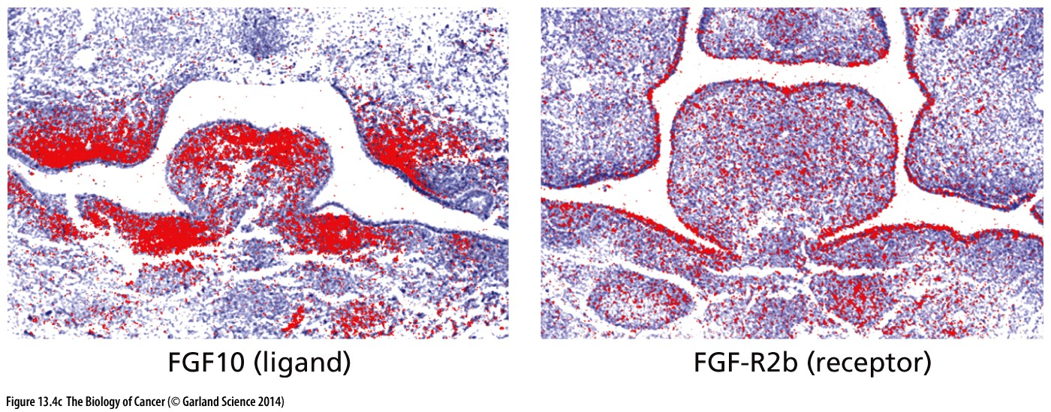
Communication and collaboration
Tissue architecture is formed and maintained by way of cell-to-cell communication
Cells communicate with endocrine and paracrine signaling
Endocrine signaling: long distances via circulation
Paracrine signaling: short distances between nearby cells
Cells that respond must have the appropriate receptors

Slide 5
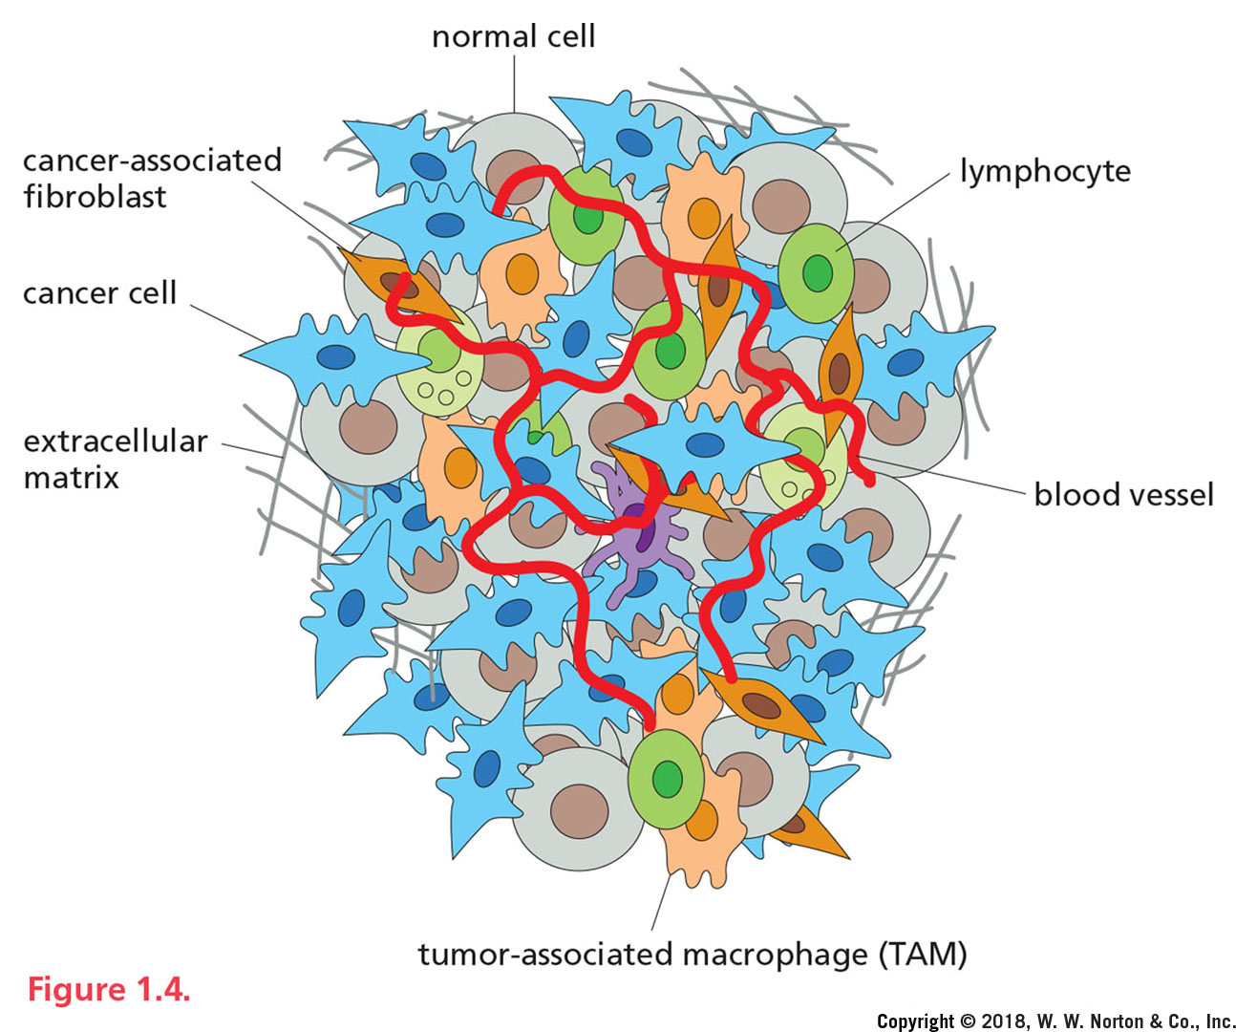
Cancer cells maintain this capacity to ‘talk’ to other cells
The tumor stroma mainly consists of the basement membrane, fibroblasts, extracellular matrix, immune cells, and vasculature.
Initially most host cells in the stroma possess certain tumor-suppressing abilities
the stroma will change during malignancy and eventually promote growth, invasion, and metastasis.

Slide 6
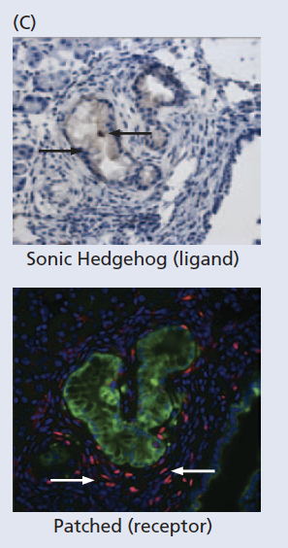
Communication and collaboration
Heterotypic signaling between epithelium and stroma in tumors is common and well documented
Once cell layer releases a ligand
The adjacent cell layer displays the cognate receptor so they can respond
Dozens of distinct molecular species mediate cell-to-cell signaling
EX: pancreatic carcinoma
Epithelial cancer cells excrete sonic hedgehog ligand
Cells in the stroma express the patched receptor

Slide 7
Communication and collaboration
And the normal cells ‘talk’ back
Key to many stages of tumor progression
EX: Tumor Initiation (from chapt 11)
Senescent cells’ release of chemokines recruit immune cells
Immune cells orchestrate an inflammatory response & release TNF-alpha → proliferation of epithelial cancer/precancer cells

Slide 8
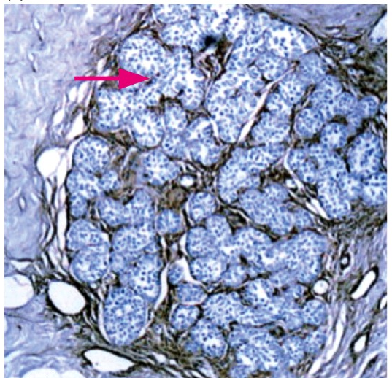
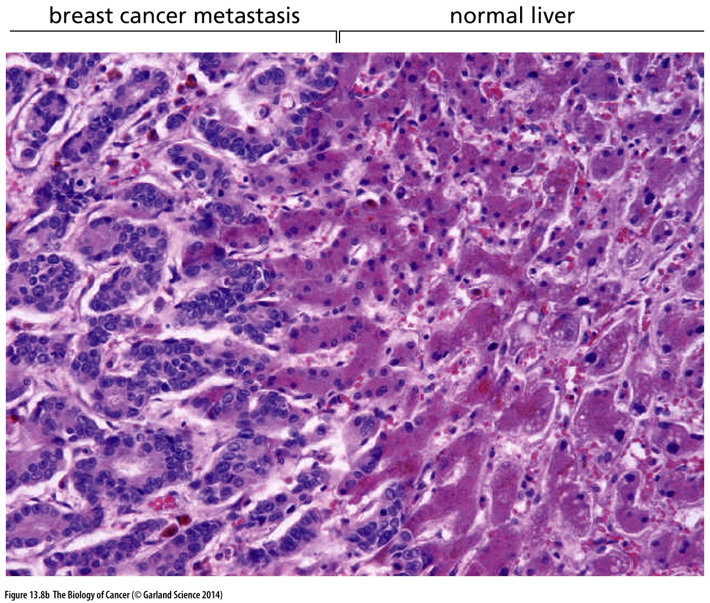
Home away from home
Most tumor cells remain dependent on stromal interactions
Often metastatic cancer cells re-establish histologically complex tissue that contains cancer and non-cancer cells
Only the most aggressive, most advanced cancers can survive without stromal cell support
Primary breast tumor
Metastatic breast tumor

Slide 9
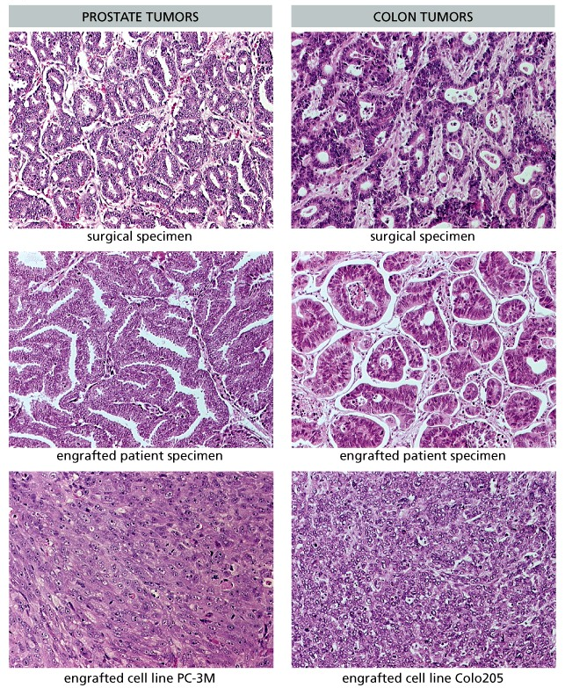
Research limitations
If cultured cells are so different from tumors, why use them at all?
Consider what you’ve learned about cell autonomous and non-autonomous behavior
What might cultured cell lines be good for? What are they likely not good for?
What about xenografts of tumor chunks? Better or worse?

Slide 10
Inflammation and Cancer
Inflammation is a critical component of tumor progression
Cancers arise from sites of infection, chronic irritation and inflammation
A vital component of the tumor microenvironment are inflammatory cells
Inflammation promotes neoplastic processes involving proliferation, survival, and migration
Tumor cells have co-opted inflammatory signaling molecules and receptors
Tumors act as wounds that fail to heal

Slide 11
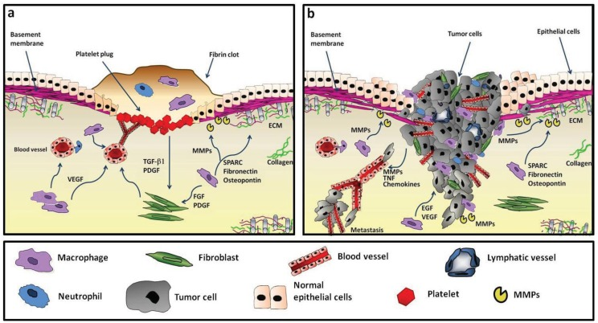
Tumor microenvironment resembles a wound
WOUND
TUMOR
Changes in the stroma
Blood platelets aggregate & release PDGF & TGFβ → attracts fibroblasts & macrophages: stimulates proliferation, and myofibroblast differentiation
Release of vasoactive factors (permeabilize blood vessels), growth factors, & cytokines → neoangiogenesis & cell proliferation
Release of ECM remodeling proteases (Matrix Metalloproteinases, MMPs)

Slide 12
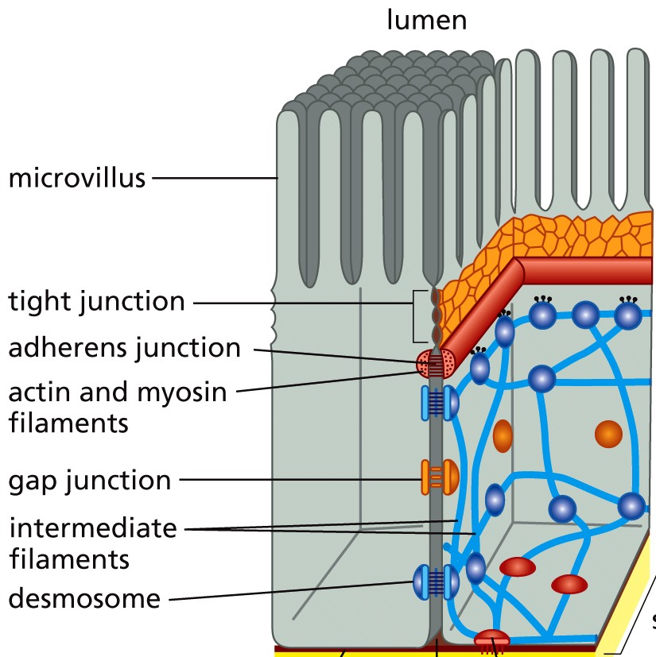
Epithelial cells at a wound
Epithelial cell undergo their own changes
To reconstruct the damaged tissue and fill the gap created by a wound epithelial cells:
Break adherens junctions, downregulate E-cadherin
Reduce adhesion to the ECM
Become mesenchymal-like (EMT: epithelial to mesenchymal transition) → more motile and invasive
Cancer cells undergo similar changes and sustain them

Slide 13
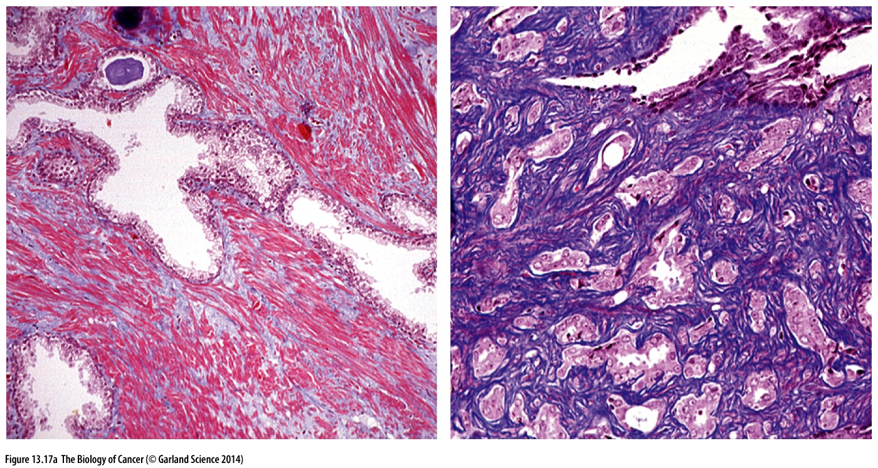
Exaggerated wound response
Wound stroma
Tumor stroma
Pulse of PDGF released by platelets
Transient deposition of ECM to promote healing
Continuous release PDGF
ECM is excessive, resulting in desmoplastic (hard) stroma
ECM becomes increasingly acellular with tumor progression
→ Attractant and mitogen for stromal cells (like fibroblasts)
Fibroblasts excrete collagen to remodel the matrix
TGFβ promotes myofibroblast differentiation
Myofibroblasts deposit Extra Cellular Matrix (ECM)

Slide 14
Surgical resection may promote growth of remaining cancer cells
The wound induced by surgery initiates a wound-healing response
Release of potent mitogenic factors that promote cancer cell growth
Cancer cells that are undetectable at the time of surgery (micrometastases) benefit from this signaling
→ promote growth and neoangiogenesis
Tumor will reoccur at the primary site or a distant site
Post-operative addition of drugs that inhibit the GF receptor decrease reoccurrence by 50%

Slide 15
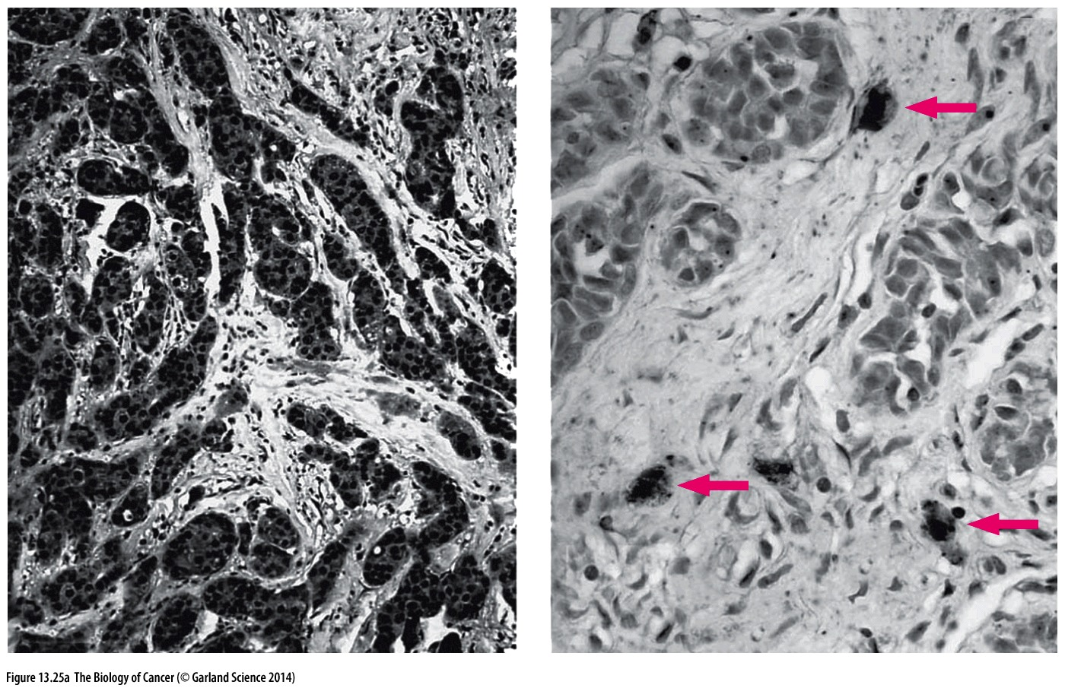
Other roles for immune response
Macrophages play an important role in angiogenesis
VEGF is a potent angiogenic factor (promotes new blood vessel formation
Sometimes cancer cells express it
Sometimes stromal macrophages express it

Slide 16
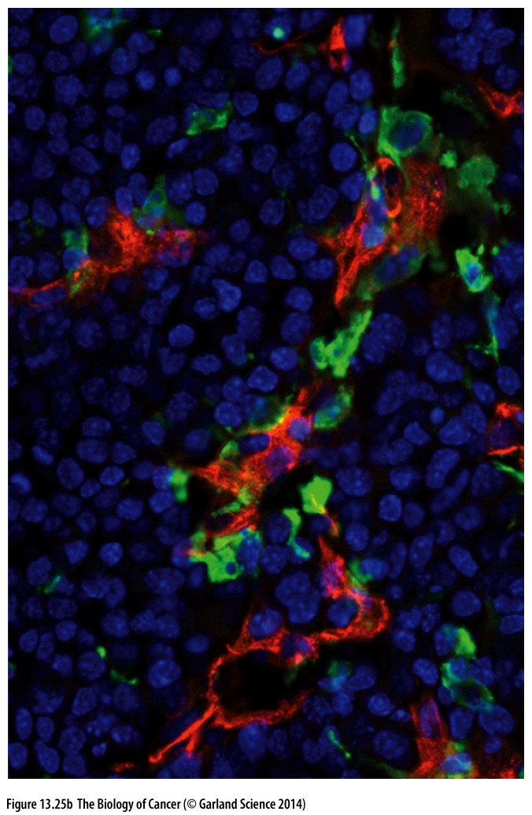
VEGF-expressing macrophages are positioned near and contribute to the development of tumor associated blood vessels
Density of macrophages in a tumor correspond with poor patient prognosis
Correlative or causative relationship?
Or both?

Slide 17
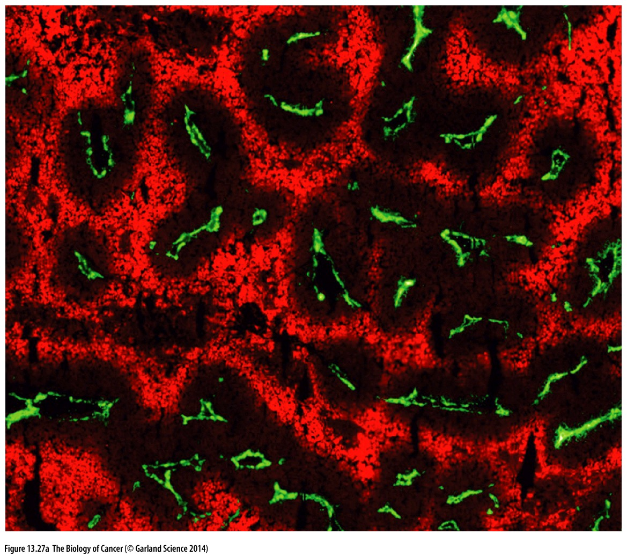
Cancer cells require access to circulatory system
Cancer cells grow preferentially around blood vessels
Diffusion through tissue is limited and tissue becomes hypoxic (oxygen poor) <100um away from capillaries

Slide 18
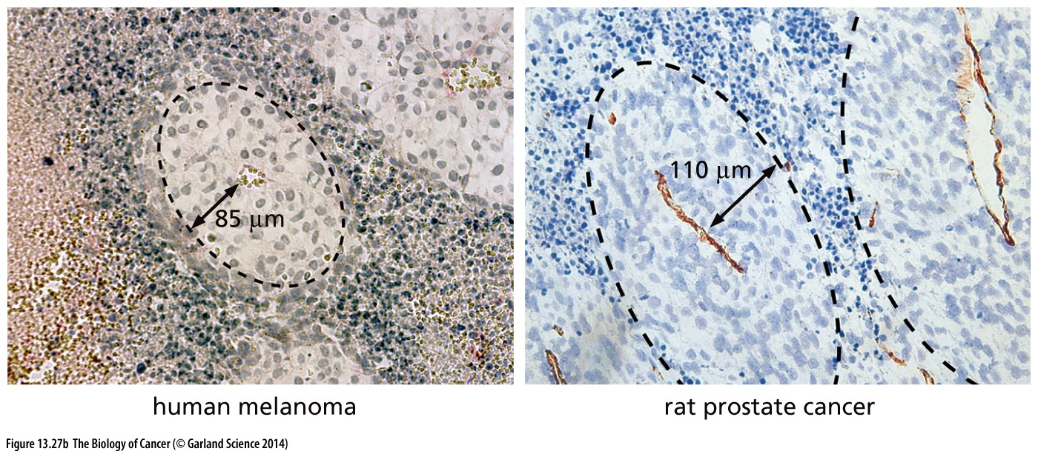
Cancer cells require access to circulatory system
Cancer cells grow preferentially around blood vessels
Diffusion through tissue is limited and tissue becomes hypoxic (oxygen poor) <100um away from capillaries
Well oxygenated cancer cells are healthy, those in hypoxic regions become necrotic

Slide 19
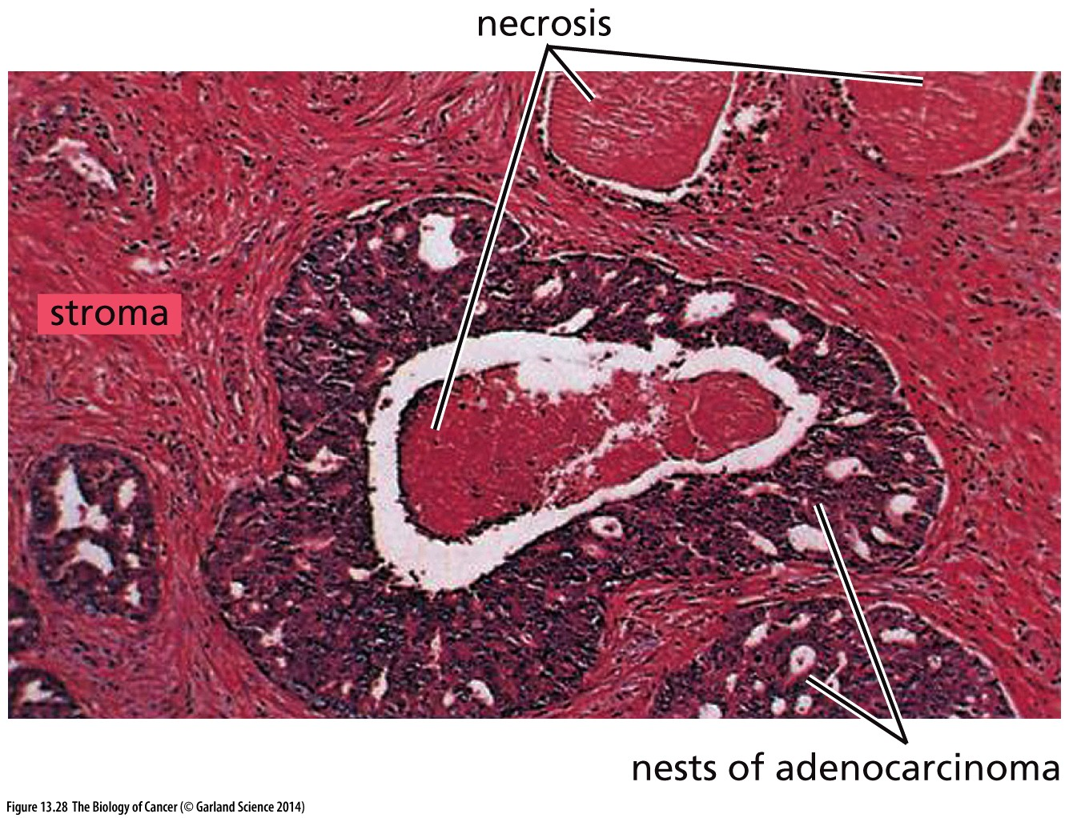
Hypoxia promotes necrosis
Advanced prostate cancer
In healthy tissue no cells are more than a couple of cell widths from a capillary
If growth outpaces the rate of new capillary formation cancer cells that lack access to the stroma (and associated capillaries) die
Capacity for neoangiogenesis represents a rate-limiting step in cancer progression → angiogenic switch

Slide 20
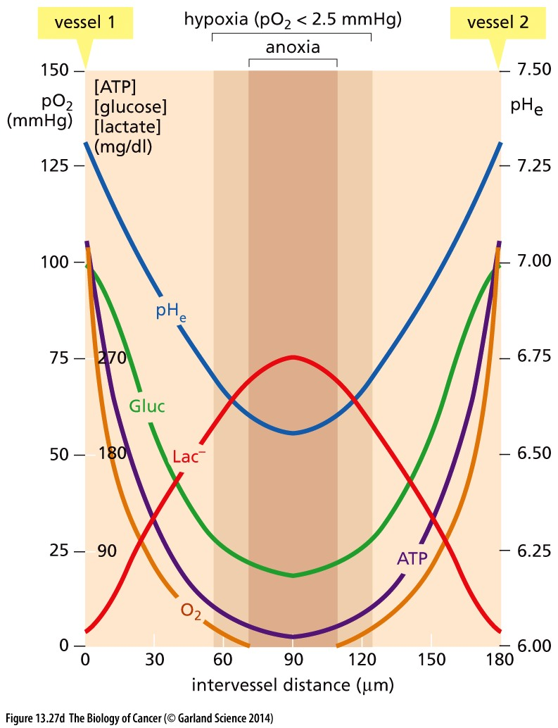
Drive for neoangiogenesis
Vasculature provides essential support to the growing tumor…
Provide:
Oxygen
Nutrients
Limit:
metabolic waste buildup
low pH

Slide 21
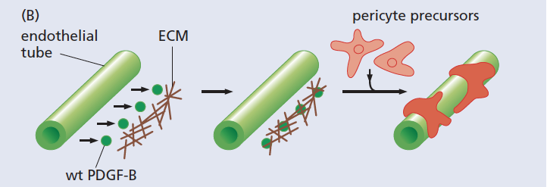
Exploiting immune response to form capillaries
Like myofibroblasts, TAMS (tumor associated macrophages) secrete MMPs (Matrix Metalloproteinases) that cleave and reorganize the ECM
Liberating mitogens
Making way new blood vessel growth, disrupting tissue, and permitting space for the growing tumor
TAMs are attracted to hypoxic regions of tumors (oxygen poor)
VEGF secretion brings endothelial cells & capillaries
Excreted growth factor is trapped locally by the extracellular matrix → high local concentration of GF
Ensures recruitment of pericytes directly adjacent to endothelial cells where they provide structural support

Slide 22
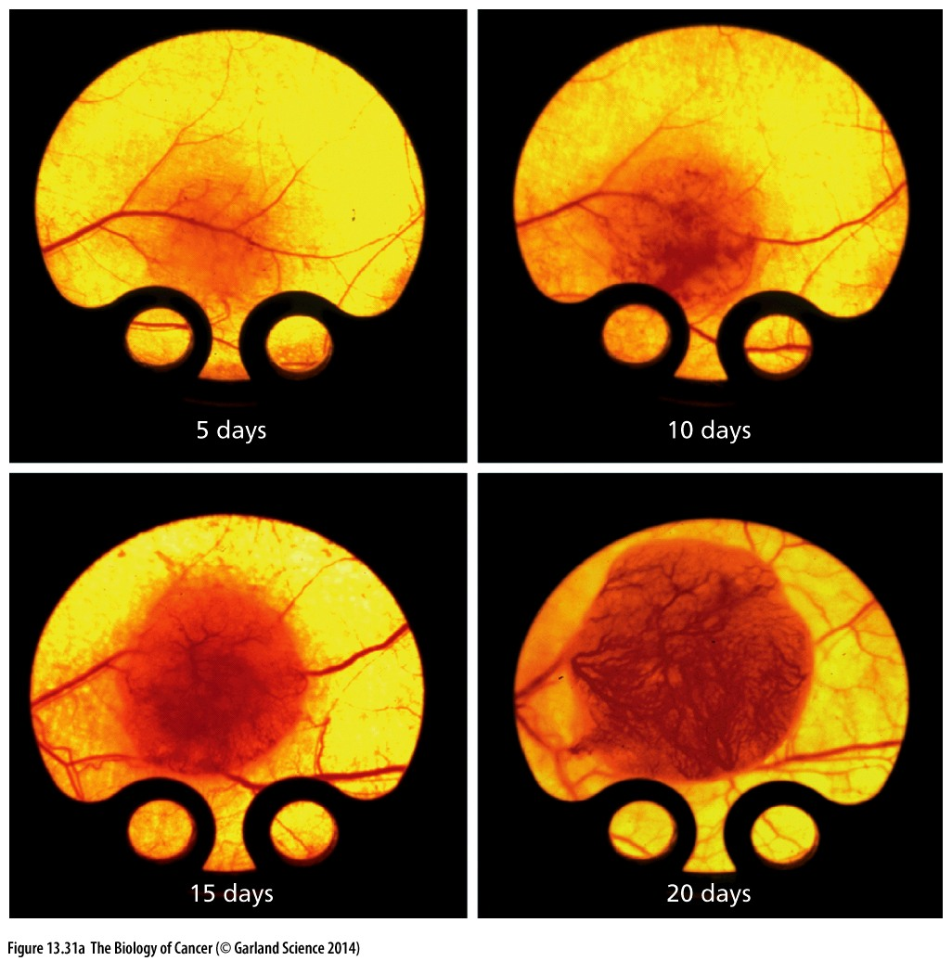
VEGF stimulates endothelial cells to proliferate and contort to form capillaries, growing towards the highest concentration of angiogenic factors
Angiogenic factors
TGFβ
FGF2
IL-8
Angiopoitin
Angiogenin
PDGF
Together promote blood
vessel formation
Tumors actively recruit blood vessels

Slide 23
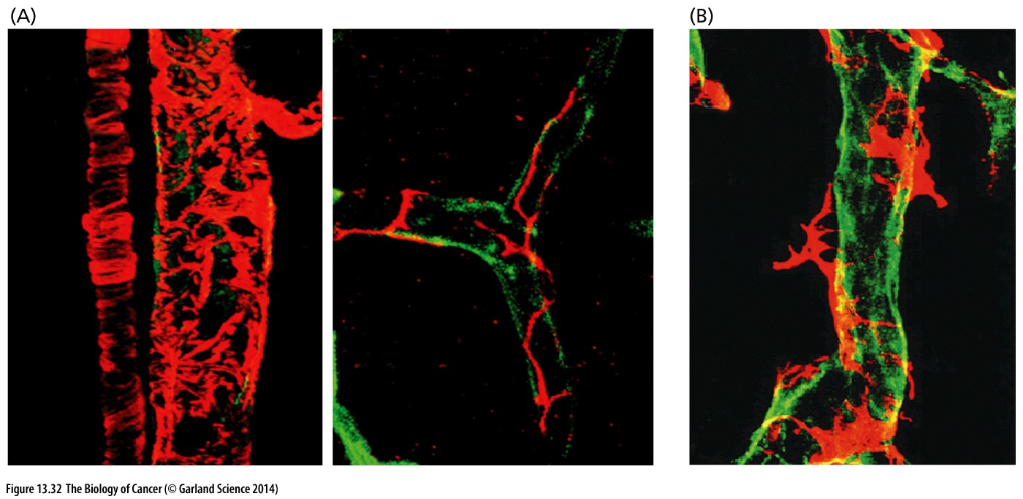
An imperfect system
Capillaries are made of multiple cell types:
Endothelial cells form the lumen
Pericytes and smooth muscle cells provide structural support
Tumor capillaries can be 3x the diameter, have disorganized pericyte coverage

Slide 24
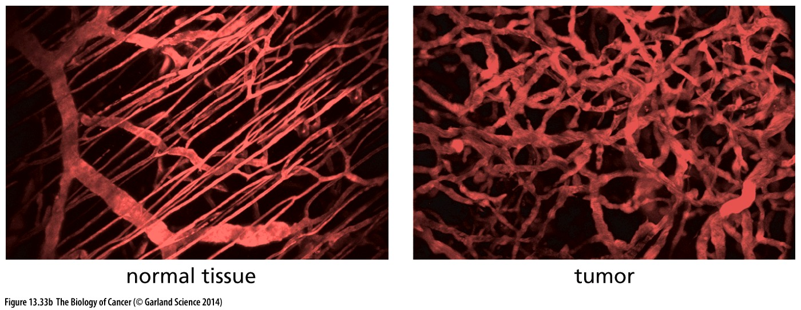
Disorganized but effective
Resulting capillaries in a tumor are disorganized
→ Grow as they are needed, not by a pre-designed plan

Slide 25
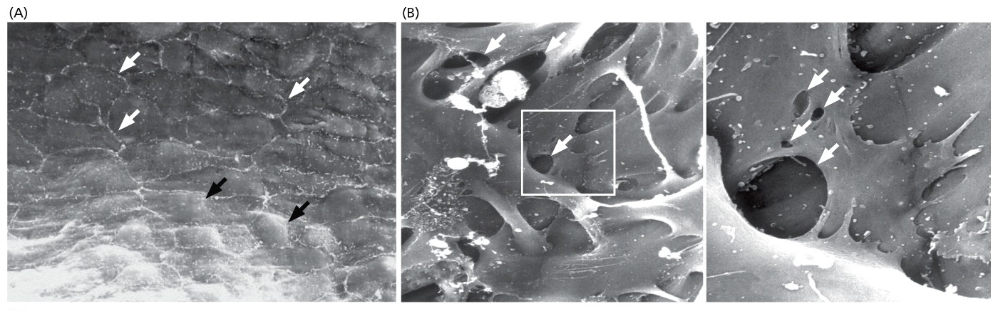
Haphazard assembly → ???
Gaps are apparent between adjacent endothelial cells of the capillary lumen
Normal mammary gland
Tumor tissue

Slide 26
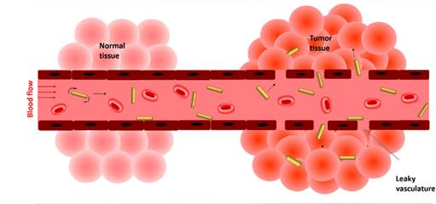
Haphazard assembly → LEAKS
High VEGF, together with Imbalance of antagonistic growth factors may compromise capillary maturation → 10x more permeable that capillaries in normal tissue
What are the consequences of these leaky capillaries?
Tong et al., 2016

Slide 27
Coopting the permeability
How might leaky capillaries impact tumor progression?
Cancer cells can get into the capillaries→ metastasize
Drugs can get in → cancer-selective therapy?
Accumulation of fluid within the tumor
Lymphatic vessels are also poorly formed, few in number, and may collapse due to tumor mass
High fluid pressure limits efficient passive transfer of drugs from blood to tumor

Slide 28
Sharing is caring, teamwork makes the dreamwork and other preschool propaganda…
Tumors are heterogeneous masses of cancer cells and normal cells
Individual cancer cells within a single tumor can be different from each other
All cells in the tumor mass benefit from angiogenesis and restructuring of the tumor microenvironment…
But not all cancer cells need to be capable of inducing these changes themselves
What does this mean for cancer therapy? Which cells do we want to target?

